Slide 1
Exploring Classroom Possibilities With Kurzweil

Slide 2
The Class
We wanted to create an inclusive environment with ample opportunities for buy-in with a group of grade 8 reluctant learners.
We booked the computer lab, assembled The Class, and introduced the program one little bit at a time. We didn’t anticipate the outcomes…..

Slide 3
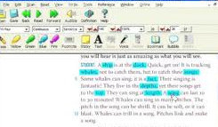
We started with high interest reading.
Humour
Suspense
Real life drama
Introducing one tool at a time, we used short, engaging stories paired with outcomes like finding main ideas, expressive language, and summarizing to hook in our learners.
Lesson Example: Found Word Poetry
Following a series of lessons in the identification and use of powerful words, students used Kurzweil to read a story “I Survived: Struck By Lightening” Students used the Highlight tool to select powerful words in the story. They then extracted their highlighted words and arranged them as a piece of poetry in a Word document.

Slide 4
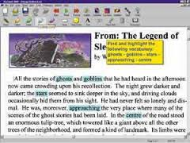
Guided Processing
Still using high interest reading, we inserted “sticky notes” at strategic places in the stories. On the “sticky notes” were questions that required students to think about the part they had just read and respond to the question posed right on the “sticky note”.
When finished, students were then able to extract the content of the “sticky notes” and hand in the completed assignment.
This was a useful strategy because the notes could be placed right near the targeted information and be answered as soon as they were encountered. We noticed that, with practice, responses became deeper and more meaningful as students’ confidence increased.

Slide 5
Literature Circles
Students chose from a group of preselected novels in our KESI library.
Using the highlighter tool, they identified unfamiliar words in their reading and found the definitions.
With the “sticky note” students did a short chapter summary at the end of each chapter.
Students used the “text note” tool to add personal comments, connections and ask questions about the book as they read.
By extracting all of this information, students came to their lit circle discussions with information and opinions to share as well as questions to discuss with their group members.

Slide 6
Some things that surprised us:
Empowerment
Some students from “The Class” started showing up with worksheets and reading from other classes asking if we could scan them into Kurzweil. We even had a student that used this option so frequently, she asked if we could teach her how to do it, so she didn’t need to wait until we had some spare time.
Attachment, Comfort, Safety
Many of these students became frequent users of the computer lab, bringing assignments from their other classes to get extra help, do homework or use the writing tools in Kurzweil to complete their work.

