Slide 1
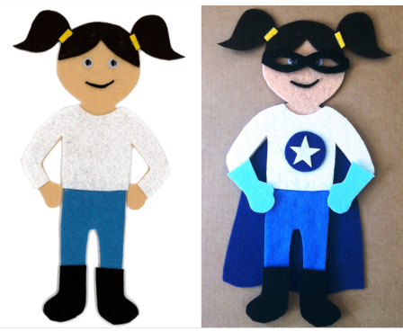
Toolbelt for AM

Slide 2
Introducing AM
AM is a grade 8 student with significant reading and writing challenges. She has recently received a tablet as a birthday gift and is keen to use it for school work.

Slide 3
TASK
AM will be required to build a Prezi to share her learning of Ancient Rome. Students will have a rubric outlining the requirements of the assignment. The rubric will be available in a digital format. Information will be sourced from class activities, the text book, and the internet.

Slide 4
ENVIRONMENT
Grade 8 Social Studies classroom. Available resources include: Student owned tablets (8 students in total make use of personal tablets – 6 ipads and 2 windows tablets), 10 classroom ipads, 4 classroom PC workstations, access to 2 digital copies of the Social Studies textbook for two qualifying students through ARC-BC

Slide 5
SKILLS
Strong verbal skills
Strong abstract reasoning
Determined
Comfortable using Kurzweil
Tries to self-correct when she hears errors in her writing
Works independently and asks for help when stuck

Slide 6
TOOLS
Google Search This page in Google Chrome allows the user to use voice to enter a search term.
Prezi
This versatile web-based slide-show tool allows the user to create dynamic, interactive slide shows. It offers a variety of templates and an option to build-your-own.

Slide 7
TOOLS(cont.)
Speakit!﻿ This Google Chrome Extension is compatible with AM’s Windows-based tablet and will read
all of the internet sites she may access in her research. As well, it will remain readily available
through Google Chrome to read any other web-based information she may access.
Split Screen
This Google Chrome Extension allows the user to open multiple windows along with a
note-taking screen in which the user can copy/paste relevant informationfor use in the SS
project.

Slide 8
TOOLS(cont.)
VoiceNote II
This voice-to-text app for Google Chrome will allow the user to have a floating text box on top of the note-taking screen from Split Screen. With this, the user can copy-paste text or use voice to put gathered information for the project into own words. This final version of relevant text can be copy/pasted into the appropriate slide of the Prezi.

